Slide 1
Post Partition Period (1947-2013)

Slide 2
Initial problems of Pakistan
Congress reaction to the establishment of Pakistan
Mountbatten wanted to become Governor-General of both India and Pakistan
Jinnah had not accepted it. Mountbatten became Governor-General of India
The Congress leaders with the cooperation of Mountbatten started to create problems for Pakistan
Formation of Government Ministry
The Congress delayed the transfer of civil servants and the official records when Pakistan was established as an independent country

Slide 3
shortage of the experienced civil servants
There was not enough stationary or furniture in the offices
Most of the civil servants were Hindus and they migrated to India
Pakistan was compelled to appoint the British officers to overcome the shortage
Division of Armed Forces and Military Assets
British commander in chief of military Auchinleck was in favor of keeping one military for both the nations
On the insistence of Muslim League he had accepted the division of the military assets
It was decided that the military assets would be divided on the ratio of 36% and 64% for Pakistan and India

Slide 4
there were 16 ordinance factories in British India which were located in those regions where India was created
Hence Pakistan was given Rs 60 million in lieu of those factories. An ordinance factory was thus established at Wah in Pakistan.
The Massacre of Muslim Refugees and their influx in Pakistan
The Hindus and Sikhs initiated the massacre of the Muslims refugees in Punjab who were migrating to Pakistan
In eastern Punjab the army of the princely states of Patiala, Kapurthala, Alwar, Bharatpur also joined Hindus and Sikhs in the massacre of the Muslims
The Muslim women, children, and poor men were slaughtered.
The Muslim women were raped and killed by the Sikhs and the Hindus.
The trains were stopped at certain places by Hindus and Sikhs in which the Muslims were killed or burned.

Slide 5
Division of Financial Assets
The total budget of the British India at the time of partition was Rs 4 Billion.
The share of Pakistan was Rs 750 million.
India initially paid Rs 200 million to Pakistan and Sardar Patel stopped the remaining amount.
Gandhi demanded that the share of Pakistan should be given, he went on hunger strike.
As a result of which the Rs 500 million was paid to Pakistan, but Rs 50 million was not given.
Canal Water Dispute
On 1st April, 1948 India stopped the water of Ravi and Sutlej at Madhopur and Ferozpur headworks respectively.

Slide 6
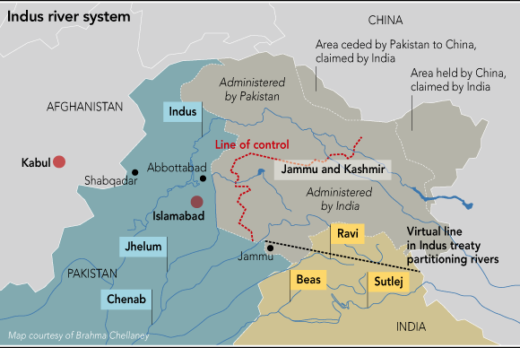

Slide 7
Pakistan’s economy was predominantly agricultural and the water was the backbone of Pakistan’s economy.
Pakistan was compelled to purchase the water from India in the initial times.
Pakistan took the issue to World Bank; as a result of which, Indus water treaty was signed between India and Pakistan in 1960.
The control of three eastern rivers: Sultej, Ravi, and Beas was given to India, and the control of three western rivers: Indus, Jehlum, and Chenab was given to Pakistan.
The Accession of Princely States
Junagarh
The ruler of the princely state was a Muslim but the majority of the population were Hindus..

Slide 8
After the partition of India Junagarh and a small contagious princely state of Manavadar gave its accession to Pakistan.
Mountbatten had not accepted the accession of these states to Pakistan and declared it as a violation of the sovereignty of India.
He surrounded the princely state of Junagarh with Indian troops and put an economic blockade by cutting of its rail links with India.
The Indian army conducted a referendum in Junagarh.
As the majority of the population were Hindus they voted in favor of accession to India
Hyderabad
The ruler of Hyderabad was a Muslim who was known as Nizam. The State of Hyderabad was a rich state economically. The annual revenue of the state was Rs 260 million, and the state had its own system of currency and postage stamps.

Slide 9
Therefore the state asked for an independent status similar to that of Pakistan and India.
Mountbatten made it clear that it was not possible for the British government to grant a dominion status to Hyderabad.
He said that the state was surrounded by the Indian Territory on all of the four sides, hence it was not possible to give it an independent status.
The Nizam instead of acceding of India demanded that the state would enter in a deal with India for combined defense, foreign affairs, and communication.
The state launched complaint against the India in United Nations Security Council.
However, before the UN could take any decision regarding the status of the state. The Indian army entered into the state and brought it forcefully under the control of Inda.

Slide 10
Kashmir
The state of Kashmir was created when the British sold it to the Dogra ruler Gulab Singh by treaty of Amritsar in 1846.
The princely state had the majority of the Muslim population but the ruler were the Sikhs. At the time of partition of sub-continent the state was ruled by the Sikh Maharaja Hari Singh.
The population wanted to accede to Pakistan. The public pressurized the Maharaja to accede to Pakistan. The Maharaja started to oppress the local Muslim population as a result of which they revolted against the Maharaja.
The Tribesmen from the North-West Frontier Province also joined the rebellion.

Slide 11
The Maharaja asked India for military assistance. India demanded to give a letter of accession to India of the state of Jammu and Kashmir. Maharaja gave the letter of accession to India; consequently, the India sent its forces to Kashmir.
When the Indian army entered the region of Kashmir, Pakistan also sent its forces in Kashmir due to which the first Kashmir war was started. India blamed Pakistan for aggression and took the issue to United Nations.
Thus United Nation Commission for India and Pakistan was created to resolve the dispute.
It was decided in the resolutions of UNCIP that a cease fire line would be created and a referendum would be held in Kashmir to ask the opinion of local population.
However no referendum was held under the UNCIP till now in Kashmir.

Slide 12
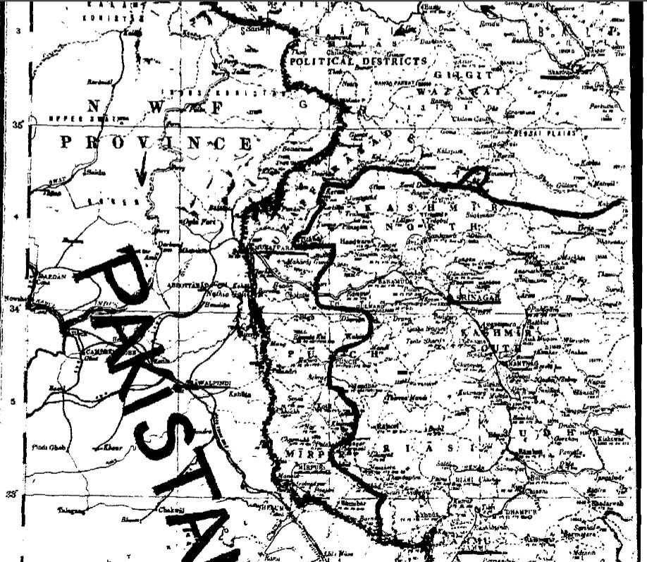

Slide 13
Economic Problems
When Pakistan was created it comprised of those regions which were economically underdeveloped.
Most of the industries were located in India e.g Calcultta was given to India during the partition of Bengal.
The agriculture was also not developed to meet the needs of the country.
The two wings of Pakistan, that is East and West Pakistan, was separated from each other with the Indian territory. The Hindus were dominating the trade and the commerce of India.
The railway system and the river transportation in East Pakistan was in depleted condition.

Slide 14
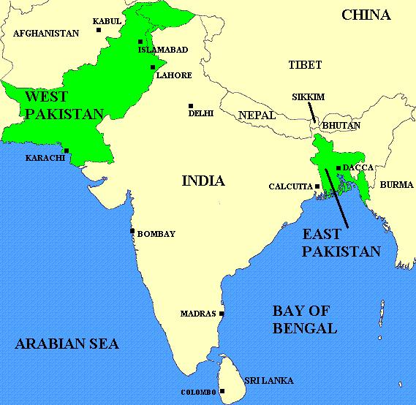
44% population
Geographical distance (separated by 1600 miles of Indian Territory
56% population
4 provinces
1 province

Slide 15
Constitutional History of Pakistan
Constitution making issues (1947-1956)
1. Secular vs Islamic State
Objective Resolution 1949: Sovereignty belong to Allah Almighty
Rights of minorities were recognized to follow their religion and
culture (Ministry for minority affairs)
Fundamental rights of the people were secured (everyone could appeal to Supreme Court
No law shall be enacted against Koran and Sunnah

Slide 16
Federalism (center and province distribution of Power)
Distribution of power between provincial and federal government was decided as per the Government of India Act 1935
Federal list (subjects on which the federal government has the legislative power.
Provincial list ( subjects on which the provincial government has the legislative power)
Concurrent list (subjects on which both the provincial and federal government could legislate- however, incase of disagreement the federal legislation would receive priority.
Residual powers was vested in the head of the state (President or Governor General)

Slide 17
Representation
1st Basic Principal committee report 1950
Equal power for both houses
cabinet responsible to both houses
Lower house structure was not clear (East Pakistan resisted)
No mention of the composition and size of the assembly
2nd Basic Principal committee report 1952
Lower house was empowered (West Pakistan) resisted.
Cabinet responsible to lower house only
Equal representation in both houses of East Pakistan vis-à-vis West Pakistan 120 upper house: 400 Lower house.

Slide 18
Bogra Formula 1953
L.H U.P joint session
East Pakistan 165 10 175
West Pakistan 135 40 175
-------
350
Both houses given equal power
Governor General Ghulam Muhammad dissolved Assembly in 1954
On 30th September 1955, west Pakistan was made one-unit, means all the provinces were merged into one province that was West Pakistan to resolve the issue of representation.

Slide 19
Language Issue
Urdu was declared as the official language of Pakistan
In 1953, Bangladeshi language movement emerged in East Pakistan
The Pakistani government tried to introduce Persian-Arabic script for the Bengali Language.
The Bangladeshi Language was recognized as the official language of Pakistan in 1956.

Slide 20
Constitution of 1956
President
Chief executive and head of state
Elected by national and provincial assembly members by majority vote
Appointment of Provincial Governors, Judges of Supreme Court, Auditor General
Summon, prorogue, and dissolve national assembly
Veto power to reject or withhold his assent to the bills.
Prime-Minister
Head of the majority party, and leader of the cabinet in the parliament.
He could be removed by the President
Cabinet Ministers are under his pleasure

Slide 21
National Assembly
300 members equally divided between the two wings of the country
10 seats for women, 5 each reserved for the women.
National assembly complete control over the finances
Governor
Governor works under the pleasure of the President who appoint him.
He is responsible for appointing Chief minister who in his view command the majority in the provincial assembly.
Provincial Assembly
Provincial legislature and Governor with 80 members elected and 10 seats for women

Slide 22
Judicial Structure
Chief Justic appointed by President
Original as well as appellate jurisdiction
High Court
The chief Justice would be appointed by President in consultation with the President.
Islamic Provisions
Pakistan was named as Islamic Republic of Pakistan
Preamble consisted the Sovereignty of Allah
Head of the state shall be a Muslim
Islamic advisory council shall be set up
No law against Islam shall be enacted.

Slide 23
Ayub Khan Era (1958-1969)
The 1956 constitution was drafted by the constituent assembly after 9 years of independence.
Not a single general election was held during this period.
The first general elections was scheduled to be held in March 1959.
President Iskander Mirza anticipated that the Awami League of the Eastern Wing would sweep the elections with a majority as result of which Muslim league would not be able to form the government.
He asked Ayub Khan the Chief of Army staff to impose Martial Law.
On 7 October, 1958 President Iskander Mirza abrogated the constitution and dismissed the central and provincial governments.
Supreme Court called the imposition of the Martial as a revolution and provided it legitimacy

Slide 24
Reforms introduced by Ayub Khan
EBDO (elective body disqualification order)
The politicians who were alleged to be corrupt they were given two options either to face trial under the EBDO or voluntarily leave politics for 6 years.
PRODO (public representative officer disqualification order)
The corrupt bureaucrats were disqualified under this order
Land Reforms 1959
A person could not own more than 500 acres of irrigated and 1000 acres of unirrigated land, and 150 acres of orchard land.

Slide 25
Green Revolution
SCARP (salinity control and reclamation program) this was intended to control the problems of water-logging and salinity
Tube wells were installs to extract the excess water out of the land.
Tractors were introduced
ADBP (agricultural development bank of Pakistan)
Provided loans to the peasants.
In 1960, Indus Water Treaty was signed as a result of which Mangla, Warsak, and Tarbela Dam was constructed. Indi gave compensation money and world bank also provide funds.
Hybrid seeds were introduced.
Pesticides and insecticides were introduced

Slide 26
Family Law Ordinance 1961
All marriages need to registered by the government
A man who want to divorce his wife must go through the conciliatory procedures of the union council.
A man want to remarry need the written permission of the first wife
Minimum age for marriage was decided
Oppostition
Jamat-i-Islami opposed the family laws of Ayub

Slide 27
Basic democracies
Divisional Council
District Council
Municipal Committee
Cantonment Board
Tehsil Council(West Pakistan)
Thana Council (East Pakistan)
Town Committee
Small Towns
Council (Village)
Town and Cities
Union Committees
Cantonment

Slide 28
Constitution of 1962
President
Executive head of the country
Elected indirectly by 80000 Basic Democrats elected directly by the people
President Powerful in appointment and removal of Governors
Reject All Bills passed by the legislature
He could issue ordinances
He could summon, prorogue and dissolve national assembly

Slide 29
National Assembly
Central legislature President and national assembly
200 members of national assembly, ten intellectuals nominated by the government. Six seats reserved for women
National Assembly had full authority in finances. It could levy taxes and pass the annual budget
National Assembly could pass an amendment by 2/3 majority.
National Assembly acted as court of law when a resolution of impeachment, conviction declaring the President as incapacitated was before the house
Governor
Provincial Chief appointed by the President and could serve under his pleasure
Ministers were appointed and dismissed by the President, who could also dissolve the assembly.

Slide 30
1965 war
The 1965 war was started due to Rann and Kutch conflict between Pakistan and India in which Pakistan gained control of some regions in Rann and Kutch.
India and China fought on the border region in 1962.
Ayub khan launched operation Gibraltar with the hope that India position is vulnerable.
Pakistan infiltrated mujahedeen in the Indian Occupied region of Kashmir from working boundary (Sialkot-Jammu).
India recognized those mujahedeen who entered the region, and started advancing its troops across cease fire line
Pakistani troops also advanced in the cease fire line and the clashes started.

Slide 31
India launched attack on Pakistan through crossing the international boundary in Punjab.
The war was fought for almost 17 days from 6-23 September 1965
Tashkent agreement 1966
USSR intervened to bring cessation of the hostilities in between India and Pakistan
USSR Prime minister Alexi Kosygin invited Ayub and Indian Prime Minister Lal Bahadur Shastri to Tashkent to sign a peace agreement

Slide 32
Yahya Khan and separation of East Pakistan (1969-1971)
On 25th March Ayub khan declared that he is transferring power to General Yahya Khan instead of elections, who also became the chief of army staff
When Yahya khan assumed the reigns of government he abrogated the 1962 constitution, banned all political activities, dismissed central and provincial assemblies and declared Martial law in the country.
The fundamental rights were suspended
There was a rise of discontentment and a sense of deprivation was assuming momentum in the East Pakistan.

Slide 33
The bureaucracy has assumed more power during the Ayub regime due to introduction of the Basic democracies.
Yahya khan has decided to transfer the power to the elected representative body as soon as possible.
He appointed chief election commissioner on 28th July, 1970.
One unit scheme was dissolved and West Pakistan province was divided into four provinces namely; NWFP, Balochistan, Sindh, and Punjab.
The princely states of Dir, Swat, and Chitral were integrated into the West Pakistan province of NWFP.
The principle of one man one vote was accepted for the general elections.
Legal Framework order (1970) was introduced in order to run the affairs of the country in the absence of the constitution.

Slide 34
It was declared that after the elections the constituent assembly has to frame constitution within 120 days of its first meeting. Otherwise the assembly would be dismissed
1970 general elections
Awami League was dominant political actor in the eastern wing of Pakistan.
It fought the elections on the six point agenda of Shiekh Mujib.
The six point agenda was aimed at turning the country into a confederation
In Western wing of Pakistan, Pakistan Peoples Party was the dominant political party. Zulfiqaur Ali Bhutto fought the elections on the concept of Islamic Socialism with the slogan of Roti, Kapra, Makan.

Slide 35
Awami league won all the seats in the Eastern Wing except 2 seats. On the other hand PPP won majority in the Western wing.
Transfer of power Mujib-Bhutto-Yahya
Mujib declared that he would make the six point agenda part of the constitution
Mujib has kept the rebellious movement active it the eastern wing of Pakistan to keep the power of the people in order to negotiate with the government.
Bhutto declared that without the involvement of his party no constitution could be framed just on the basis of the dictates of the majority party.
The session of the National Assembly was delayed due to the deadlock in between Bhutto and Mujib

Slide 36
Bhutto went Dhaka to held negotiations with Mujib on 26th January 1971. However, Mujib remained adamant on his demand of six point agenda to be made the part of the constitution.
Yahya Khan postponed the assesmbly session because Bhutto said that if the session of assembly took place he would launch a great movement in the West Pakistan.
On 2nd March 1970, Mujib launched civil disobedience movement in the eastern wing of the country.
Yahya khan called a meeting of the 12 elected members from the two wings of the country to decide the date for the session of the National assembly.
Yahya khan decided that the session of the national assembly would held in Dhaka on 25th March, 1971.

Slide 37
Mujib demanded to lift the martial law from the country, transfer the power to the elected representatives of the people, and stop military build up from the Eastern Wing of the country.
Civil War in Eastern Pakistan
It was not accepted as a result of Awami league decided to declare independence from the West wing of Pakistan on 24th March, 1971.
Yahya khan ordered the military to bring the law and order situation to normalcy. Mujib and other political leaders were arrested, as a result of which civil war was started in the East Pakistan.
The onset of the civil war compelled large number of people to take refuge in India.
This provided India an opportunity to intervene and resolve the civil war.

Slide 38
In November, 1971, Indian troops crossed the border, and assisted the Mukti-Bahini (independence Guerilla forces) to launch attacks against Pakistani troops.
On 3rd December, 1971 a war started between India and Pakistan. The war was fought on the border between West Pakistan and India and in the Kashmir valley.
On 16th December 1971 the East Pakistan became independent.

Slide 39
Z.A Bhutto era (1972-1977)
The defeat of the army in the 1971 war has greatly decreased the legitimacy of the army in Pakistan. Consequently, Yayha khan abdicated and Z. A Bhutto became the President and Civilian Chief Martial administrator on 20th December 1971.
Reforms introduced by Z.A Bhutto
Nationalization of the industries
In January 1972, 31 industries were taken over by the government which included the industries related to iron and steel, basic metals, heavy engineering, motor vehicles, chemicals, cement, and electricity.
In the second phase of the nationalization the rice husking units were nationalized in 1976
The private commercial banks were also nationalized

Slide 40
The insurance business were also nationalized. The State life insurance was thus established in 1972.
Land Reforms
The landowners could keep 150 acres of irrigated in first phase (1972) and 100 acres of irrigated land in second phase (1977).
For the unirrigated land, the landowners could keep 30 acres in the first phase (1972), and 200 acres in the second phase (1977).
Labor Reforms
The reforms introduced under the Labor Law ordinance of 1975; in which the medical coverage during work, group insurance, safeguard against the arbitrary termination of the employment, and the propagation of the trade unions was introduced.

Slide 41
Health Policy
New hospitals and dispensaries were opened all over the country
Educational Reforms
New universities were opened at Multan, and Sukkhur.
New educational boards for intermediate were opened at Saidu, Gujranwala, Bahawalpur, and Khairpur.
Engineering colleges were given the status of universities at Karachi, Peshawar, and Jamshoro.
Islamic Reforms
The organization of Islamic Council was formed on the suggestion of Saudi Arabia. The 1st session of OIC was held at Lahore in 1974.
Due to the mounting pressure from the religious groups against the Quaidianis. They were declared as non-Muslims in 1974.

Slide 42
Ministry of religious affairs was established for the first time in Pakistan.
The number of religious programs were increased in the radio, and television.
The Arabic was taught in schools
Alcohol, and night clubs were banned.

Slide 43
Constitution of 1973
President
Parliamentary system introduced in which the power was vested with the Prime minister and his cabinets
President could summon the joint session of both the houses
Dissolve assembly on advice of prime minister
President has limited authority in Legislation
If the president is unable to give his assent within the stipulated time, the bill will be considered as passed
President appoint the Governors, Attorney General, Chief Justis, Chief Election Commissioner, Army and Navy Force.
President could issue proclamation of emergency

Slide 44
Permanent body cannot be dissolved. The term of the members is six years. Half of the members elected by the provincial assemblies retire after 3 years.
Judicature
A supreme court and a high court
The chief justice and other judges would by appointed by the President

Slide 45
Zia-ul-Haq Era (1977-1988)
PPP government has dismissed the provincial governments of NWFP and Balochistan. Governor rule was imposed on the advice of the President in the provinces under the section 58-2B.
The elections were scheduled to be held in 1977. PPP won majority seats in the general elections of National assembly. The opposition parties joined hands to boycott the provincial elections. They formed Pakistan National Alliance (PNA).
The conditions of the country was getting worse politically due to the clashes and demonstration of the opposition against the Bhutto victory.
Imposition of the Martial Law
Zia-ul-Haq imposed Martial law on 5th July 1977. The fundamental rights of the people were suspended

Slide 46
However, Zia has not abrogated the constitution of 1973, rather he issued Provincial constitutional order in 1981 with the promise of restoring democracy as soon as possible.
The political activities were banned. All political parties were dismissed and no new political party was allowed to establish itself.
Movement for the restoration of the Democracy was launched in the province of Sindh by the supporters of PPP.
Zia-ul-Haq decided to hold referendum to decide whether the people are with him or not.
The question which was asked in the referendum from the people was;
“whether the people of Pakistan endorse the process initiated by General Muhammad Zia-ul-Haq, The President of Pakistan for bringing laws of Pakistan in conformity with the injunctions as laid down in the Holy Quran and Sunnah of the Holy Prophet and for the preservation of the ideology of Pakistan and for the smooth and orderly transfer of power to the elected representatives of the people”

Slide 47
The option of Yes or No was given to the people.
97.7 % of the people voted in favor of the retention of the Zia rule
Elections 1985
The elections were announced by Zia to be held on February 1985.
The elections were to be held on non-party basis
Separate electorate would be maintained for the minority representation
Armed forced would assist the election commission and the civil forces for conducting the elections.
Zia introduced Revival of Constitution of 1973 Order with some key amendments.
The arbitrary powers were increased of the President.

Slide 48
Muhammad Khan Junejo was made the Prime minister and Zia took oath of President on 23rd March 1985.
Muhammad Khan Junejo demanded that the Martial Law should be lifted as a result of which it was finally lifted on 30th December, 1985.
Ojhri Camp Disaster
It was a depot established during the British period where the British kept their arms and ammunition.
On 10 April, 1988, a fire broke out in that depot due to which there occurred severe explosion. There were missiles, rockets, and bombs in that depot.
Junejo appointed a commission to investigate the incident. The report of the commission held the former chief of ISI Akhtar AbdurRehman, and sitting chief of ISI General Hamid Gul responsible for the incident.
In order to avoid the trial of the ISI chiefs, Zia dismissed the elected government of Junejo, and accused him of corruption

Slide 49
Benazir Bhutto Era (1988-90)
The plan of Zia was crashed near Bahawalpur.
Benazir Bhutto has filed a petition in the supreme court for the restoration of the political parties. Supreme court adjudicated the case in her favor.
The elections were held in 1988 in which PPP emerged as the single largest party. Islami Jamhoori Itehad which was formed by Nawaz Sharif PML before the elections become the second largest party.
Benazir was appointed as the first women prime minister of Pakistan in 1988, Ghulam Ishaq khan became the president.
The center and provincial government relationship were deteriorated.

Slide 50
PPP government dissolved the Baluchistan assembly only after two weeks.
The government of Punjab ran by the IJI leader Nawaz Sharif also faced strained relationship with the central government of PPP.
Nawaz Sharif in collusion with the President Ghulam Ishaq khan planned to dissolve the assembles.
The 8th amendment that was passed during the Zia era has provided the president the powers to dissolve the assemblies both central and provincial in certain circumstances. However, the certain circumstances were not clarified by him what it meant.
The political conditions of Sindh also deteriorated due to the strained relationship of MQM with PPP.
A no confidence motion was put forward by IJI in the provincial assembly. On August 1990 Ghulam Ishaq Khan using his Presidential powers dissolved the assembly.

Slide 51
Nawaz Sharif Era (1990-1993)
The IJI under the leadership of Nawaz Sharif won the majority seats in National and Punjab assembly.
Nawaz Sharif became the President and Ghulam Ishaq Khan became the President.
Reforms introduced by Nawaz Sharif
Privatization program was initiated by Nawaz Sharif. In 1991-92, 35 units were privatized. In 1992-93, another 28 units were privatized. The two commercial banks MCB and Allied banks were also privatized.
A Yellow cab scheme was introduced for providing job opportunities to the unemployed people.
Construction of motorways was also initiated to connect Islamabad to Lahore and Peshawar.

Slide 52
Dissolution of Nawaz Sharif government
Disagreement emerged between the Nawaz Sharif and Ghulam Ishaq Khan over the appointment of Chief of army staff.
Ghulam Ishaq khan ignoring the discretionary power of the Prime minister in appointment of the chief of army staff appointed General Ashraf Kakar as the Chief of Army staff.
Nawaz Sharif did not has the majority in the National Assembly to scrap the 8th amendment from the constitution that gave the President power to dissolve the assemblies both provincial and the central.
Benazir entered into a deal with the President to dissolve the assembly, she promised that she would make him President on the day she became President.

Slide 53
President dismissed the assembly and charged Nawaz Sharif of indulged into corruption in the privatization process.
Nawaz Sharif challenged the dissolution in the supreme court as illegal and unconstitutional.
Supreme court restored the government.
The President moved a no confidence motion in the NWFP to thwart the government.
At the end Nawaz Sharif was compelled by the Chief of army staff to resign, which he has not opposed and resigned in 1993.

Slide 54
Benazir Bhutto Era (1993- 1996)
The general elections for the national assembly were held on 6th October, 1993.
PPP won the majority while Nawaz Sharif PML was not able to compete PPP.
Benazir became Prime minister for the second term, and Farooq Ahmed Khan leghari became the President.
Political conditions
PML formed a coalition government in NWFP which was ousted after two months of its formation.
The law and order conditions deteriorated in Karachi in which PPP conducted extra judicial killing.

Slide 55
Asif Ali Zardari the husband of Benazir came under sever criticism due to his involvement in corruption.
Judges case
The supreme court of Pakistan gave a judgment on the appointment of the judges.
The PPP government resisted that judgment which was a violation of the constitutional method that the executive and the judicial authorities should work in assistance with the supreme court.
The Jamaat-i-Islami gave a sit in in front of the National Assembly.
The President using his powers under article 58-2B dissolved the assembly on the charges of corruption.

Slide 56
Nawaz Sharif Era (1997-1999)
Imran Khan formed his party with the name Pakistan Tehrik-e-Insaf few days before the general elections were scheduled.
The general elections were held on 2nd February 1997 in which PML (N) won majority of the seats in Punjab and Sindh.
Nawaz Sharif became Prime minister.
National Debt Retirement scheme
The scheme was introduced to relieve the economy of its devastated status.
Domestic debt 1987 Rs. 247 billion which became Rs.908 billion
External debt 1987 Rs. 208 billion which became Rs. 809 billion

Slide 57
Accountability
Accountability cell was established with the purpose of dealing with those officials who were found engaged in corruption.
13th constitutional amendement
The article 58-2B that gave powers to the President to dissolve the provincial assembly and the article 112(2) which gave power to dissolve the national assembly was taken away from the president.
Motorway (M2)
On 26th November, 1997 Nawaz Sharif inaugurated the Lahore-Islamabad motorway.
The motorway was aimed to link the land locked countries of central Asia to the sea port of Pakistan.
It was important for transporting the goods for agricultural and industrial development.

Slide 58
Nuclear Missile
On 28th May, 1998, Pakistan in response to the nuclear explosions of India conducted explosion of nuclear weapons at Chaghi.
Lahore Declaration
On 20th February Indian Prime minister Atal Bihari Vajpayee came to Lahore for inauguration of Delhi-Lahore bus service.
Both the leaders decided to do every effort to bring peace in the country, and to commit themselves to the nuclear disarmament.

Slide 59
Musharaf Era (1999-2008)
The government of Nawaz Sharif was dismantled by the chief of army staff General Pervaiz Musharaf.
Nawaz Sharif has agreed to the cease fire on the Kargil issue on the advice of USA, and deposed General Pervaiz Musharaf as the chief of army staff.
The senate, national assembly and the four provincial assemblies were dissolved by General Musharaf.
He introduced the Local government setup on the similar lines on which it was existed on the rule of previous military rulers.
Agra Summit
As a result of the Kargil clash the relations between India and Pakistan was strained.

Slide 60
Indian Prime minister Atal Bihari invited Pervaiz Musharaf for a dialogue.
Pervaiz Musharaf started dialogue with Atal Bihari on 14th August 2001.
They discussed the cooperation on trade, visa restriction, exchange of technology.
Pervaiz Musharaf demanded that no peace and no agreement could be reached in between the two countries if the Kashmir issue has not been taken into account.
The talks failed on this point.
War on terror
On 9th September 2001, The World trade center, and Pentagon was attacked through the hijacked plane.

Slide 61
USA held Osama Bin Laden responsible for the attacks and demanded the Taliban regime in Afghanistan to hand him over to them.
Taliban government has rejected the allegation of USA
On 7th October, USA along with Britain invaded Afghanistan.
President Bush called Musharaf to ask that whether he is with him or on the side of the Taliban regime. Musharaf sided with USA.
The USA and Pakistan agreed that Pakistan would share the intelligence, provide the bases in Pakistan to launch attacks in Afghanistan, and provide logistical support.
The religious parties opposed the decision of the Musharaf regime for taking the side of USA. Demonstrations were held at Peshawar and Quetta.

Slide 62
National Referendum 2002
Some political parties opposed it which included: PPP, PML(N), ANP, and MQM.
Some parties supported the referendum: PTI, and PAT
Despite of opposition Musharraf won the referendum.
16th Constitutional amendment
The article 58-2B was reintroduced that increased the power of the President to dismiss the provincial governments.
17th Constitutional amendment
It provided Musharaf to keep two offices at the same time that is chief of army staff and President.

Slide 63
Removal of Chief Justice of Pakistan
Musharaf removed the chief justice of Pakistan on the charges of misconduct.
The lawyers started to stage protest all over the country and demanded to restore the chief justice.
Charter of Democracy
Benazir and Nawaz Sharif were in exile. They met in London and signed charter of Democracy. The charter was aimed to promote democracy and eliminate the influence of the army in the politics of Pakistan.
Benazir arrived in Pakistan on 18th October 2007, she was attacked on the day she arrived. The suicide attack at her rally killed almost 150 people.

Slide 64
Musharaf declared emergency in Pakistan due to increase suicide bombings on the government and military institutions. The constitution was suspended.
The terrorist activity was increasing due to which Musharaf launched operation against Lal Masjid and its supporters in Swat.
Nawaz Sharif also returned from exile on 25th November 2007 with the mediation of Saudi king.
Musharaf abdicated from the post of Chief of army staff and General Ashfaq Pervaiz Kiyani became the new army chief.
General Elections
The general elections were scheduled to be held on January 2008, but due to the assassination of Benazir Bhutto it was delayed.

Slide 65
The opposition started to demand the restoration of the judiciary and Musharaf to step down.
The PPP won major seats in three provinces of Baluchistan, Sindh, and Punjab. In NWFP ANP won majority.
The long March of Lawyers
On 17th May 2008, The Lawyers gathered in Lahore to discuss the restoration of the chief justice of Pakistan.
They decided to start a long march from Lahore to Islamabad.
The members of civil society and the political parties also joined them
The political parties which came to join hands with lawyers included PML-N, JI, PTI

Slide 66
Formation of the coalition government
Nawaz Sharif joined the coalition of Zardari and ANP to form a coalition government
Nawaz Sharif and Zardari signed Murree declaration in which it was decided to restore the deposed judges.
The coalition also went ahead to compel Musharaf to step down.
All of the four provincial assemblies passed the no confidence motion against Musharaf.
Musharaf agreed to resign and on 18th August 2008 Musharaf resigned from the post of President.

Slide 67
Asif Ali Zardari Era (2008-2013)
Asif Ali Zardari became the President while Syed Yousaf Raza Gilani became the Prime minister of Pakistan.
Pak-China Friendship
Asif Ali Zardari visited China on the invitation of China on 20th February 2008.
Pakistan and China passed several agreements which included power, agriculture, finance, banking, infrastructure development, and bilateral trade.
It was decided that China would construct small dams in Pakistan.
China would invest $448 in the production of hydel power in Pakistan.
Gawader port would be established by China.

Slide 68
China would open also open the commercial banks in Pakistan
The railway link and access to the Gawader port would be established as well.
Second Long March
The first long march has not restored the deposed chief justice of Pakistan, hence the lawyers decided to conduct the second long march.
It was decided that they would began their second long march from Karachi to Islamabad.
PML-N and PTI joined the long march of the lawyers.
However, the chief justice was restored before the long march reached Islamabad.

Slide 69
Military operations
The operation against Lal masjid in Islamabad by the Musharaf government had incited the expansion of the counter attacks by the religious fundamentalist in Swat.
The movement with the name of Tanzeem-e-Nifaz-e-Shariat-e-Muhammadi (TSNM) was launched by Maulana Sufi Muhammad.
Meanwhile the Tehrek-e-Taliban-i-Pakistan TTP which was waging a Jehad against the Pakistani military since the military has joined hands with the USA. TTP was attacking the NATO supply also.
TTP joined hands with TSNM
An agreement was signed between Maulana Sufi Muhammad and government Nizam-e-Adl regulation 2009, in which the Sharia was enforced in Malakand and Bajaur agency.

Slide 70
Operation Rah-e-Rast
Sufi Muhammad declared the rest of the country as unIslamic and all its institutions as Wajib-ul-qatal. They started to attack the government institutions and the law and order conditions of the region deteriorated.
The government called an ALL Parties Conference to decide about the military operation in Swat all parties passed an unanimous resolution an approved the military operation in Swat. All political parties supported the resolution except PTI. Imran khan supported the actions of TTP and TSNM in Swat.
On 28th April, 2009 the military launched an operation to get rid of the extremist forces of Mualana Sufi Muhammad.

Slide 71
Operation Rah-e-Nijat
After the completion of the operation at Swat, the government contemplated another operation against the stronghold of TTP in South Waziristan.
18th amendment
NWFP was renamed as Khyber Pakhtunkhwa
17 ministries were devolved to the provinces to bring forth the provincial autonomy.

